Slide 1
Lecture 5
Descriptive Statistics

Slide 2
What we have Covered
Week 1 – What Data Science is and the Data Science process
Week 2 – The uncertainty in Data and The Propagation of Error

Slide 3
Aims of the Lecture
A review of the central tendency
Mode
Median
Mean
The spread of data
Range
Other Quartiles
Variance
Standard Deviation
Standard Error

Slide 4
The Centre of the Data
There are typically three measures of the centre of a data set
What are they?
MEAN, MEDIAN and MODE

Slide 5
Let’s take a look at some Data
What can this data tell you?
79,77,80,79,76,76,0,61,74,82,81,36,82,67,71,77,59,70,54,81,80,83,79,78,61,72,76,82,83,79,80,82,77,49,81,80,35,76,83,78,83,68,76,65,81,80,83,72,83,45,81,79,66,40,81,77,74,0,78,0,73,75,73,83,68,72,83,75,78,71,72,61,74,81,77,51,78,82,82,79,75,82,78,81,80,80,80,79,82,83,80,80,81,80,81,80,81,71,81,76,73,78,61,76,81,77,74,75,78,81,74,80,80,82,78,75,77,75,81,77,79,69,83,80,61,80,81,81,59,76,75,83,82,79,78,0,82,70,81,73,77,49,41,71,82,0,75,75,75,51,83,82,80,76,77,81,78,82,82,77,80,75,70,78,78,83,72,77,74,82,80,57,76,76,82,83,82,75,80,82,83,68,81,77,81,82,83,80,83,80,79,80,64,63,77,0,63,45,81,78,75,80,80,78,79,69,78,78,80,81,82,69,83,60,81,76,82,79,64,50,79,80,72,67,79,81,81,78,78,77,83,79,73,83,65,72,82,73,80,83,63,81,82,41,71,82,76,82,79,82,59,76,80,64,76,78,82,76,56,75,79,80,81,78,80,77,39,0,75,80,18,80,72,79,57,59,73,78,66,77
What is the lowest or maximum mark?
What is the average mark?
What is the spread of marks?
What is the deviation from the average mark?
How many students achieved an A (first class mark)?

Slide 6
Before we begin…
Data Wrangling (munging)
the process of transforming and mapping data from one "raw" data form into another format with the intent of making it more appropriate and valuable
I scaled the data
Data Cleaning
the process of detecting and correcting (or removing) corrupt or inaccurate records from the data
let’s remove the outliers (those that did not submit at all)
Could be that the student transferred to another University (not sure why they would do that)
We have accounts in BB that wouldn’t submit, i.e. Myself and Gareth, but also program leaders, external examiners, etc. So fair to say they should not be included in the statistics

Slide 7
Let’s assume you got 91%
Feeling pretty proud of yourself?
Really?
We will look at the three common measures of central tendency and compare the score of 91% with the average
Before we do this we will have a quick recap on how to calculate the average

Slide 8
The Mode
[39, 23, 3, 23, 7, 56, 29, 13, 20, 14, 40, 23, 12, 5, 23]
Given the data set, what is the mode?

Slide 9
The Mode
To find the Mode (Modal) we look for the value that occurs most often
In small data sets the mode might not exist (but we can create groups)
The job is much easier if we put the values in order
3, 5, 7, 12, 13, 14, 20, 23, 23, 23, 23, 29, 39, 40, 56

Slide 10
The Mode
3, 5, 13, 13, 13, 13, 20, 23, 23, 23, 23, 29, 39, 40, 56
Having two modes is called bimodal
More then two modes is multimodal

Slide 11
The Mode (grouping)
3, 5, 11, 12, 14, 16, 20, 23, 25, 27, 28, 29, 39, 40, 56
0-9 (2 values)
10-19 (4 values)
20-29 (6 values) → Mode is 25
30-39 (1 value)
40-49 (1 value)
50-59 (1 value)

Slide 12
Mode with our Data
22,42,43,47,48,49,49,54,54,59,59,60,61,61,65,67,69,69,71,71,71,71,72,73,73,73,73,73,76,76,76,77,77,77,78,78,80,80,81,81,82,82,82,83,83,83,84,84,84,86,86,86,86,86,87,87,87,87,87,87,87,87,88,88,88,88,88,88,88,89,89,89,89,89,89,90,90,90,90,90,90,90,90,90,90,90,90,90,90,90,92,92,92,92,92,92,92,92,92,92,92,92,92,92,92,92,93,93,93,93,93,93,93,93,93,93,93,93,93,93,93,93,93,94,94,94,94,94,94,94,94,94,94,94,94,94,94,94,94,94,94,94,94,94,94,95,95,95,95,95,95,95,95,95,95,95,95,95,95,95,95,95,95,96,96,96,96,96,96,96,96,96,96,96,96,96,96,96,96,96,96,96,96,96,96,96,96,96,96,96,96,96,96,96,96,96,98,98,98,98,98,98,98,98,98,98,98,98,98,98,98,98,98,98,98,98,98,98,98,98,98,98,98,98,99,99,99,99,99,99,99,99,99,99,99,99,99,99,99,99,99,99,99,99,99,99,99,99,99,99,99,99,100,100,100,100,100,100,100,100,100,100,100,100,100,100,100,100,100,100,100,100
91? Not too bad, but the mode (most common value) is 96
Less happy with 91? Let’s take a look at the median.

Slide 13
The Median
[3, 5, 11, 12, 14, 16, 20, 23, 25, 27, 28, 29, 39, 40, 56]
Given the data set, what is the median?

Slide 14
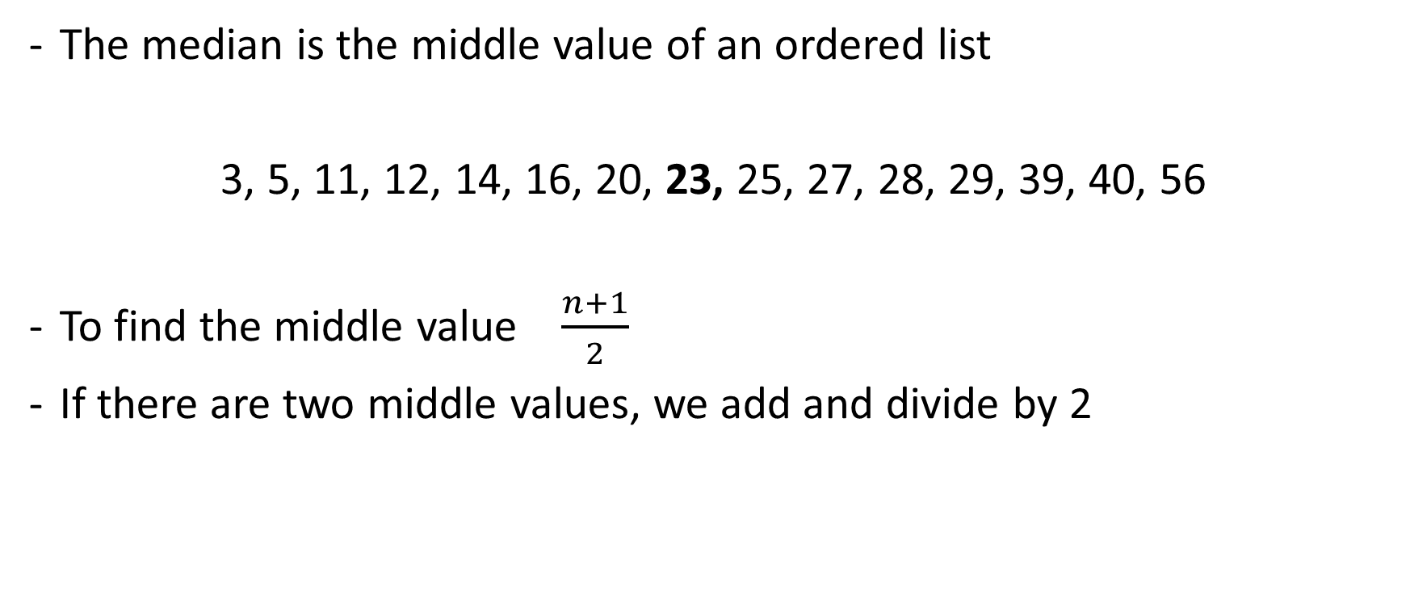
The Median
The median is the middle value of an ordered list
3, 5, 11, 12, 14, 16, 20, 23, 25, 27, 28, 29, 39, 40, 56
To find the middle value $\frac{n+1}{2}$
If there are two middle values, we add and divide by 2

Slide 15
Median with our Data
22,42,43,47,48,49,49,54,54,59,59,60,61,61,65,67,69,69,71,71,71,71,72,73,73,73,73,73,76,76,76,77,77,77,78,78,80,80,81,81,82,82,82,83,83,83,84,84,84,86,86,86,86,86,87,87,87,87,87,87,87,87,88,88,88,88,88,88,88,89,89,89,89,89,89,90,90,90,90,90,90,90,90,90,90,90,90,90,90,90,92,92,92,92,92,92,92,92,92,92,92,92,92,92,92,92,93,93,93,93,93,93,93,93,93,93,93,93,93,93,93,93,93,94,94,94,94,94,94,94,94,94,94,94,94,94,94,94,94,94,94,94,94,94,94,95,95,95,95,95,95,95,95,95,95,95,95,95,95,95,95,95,95,96,96,96,96,96,96,96,96,96,96,96,96,96,96,96,96,96,96,96,96,96,96,96,96,96,96,96,96,96,96,96,96,96,98,98,98,98,98,98,98,98,98,98,98,98,98,98,98,98,98,98,98,98,98,98,98,98,98,98,98,98,99,99,99,99,99,99,99,99,99,99,99,99,99,99,99,99,99,99,99,99,99,99,99,99,99,99,99,99,100,100,100,100,100,100,100,100,100,100,100,100,100,100,100,100,100,100,100,100
91? Not too bad, but the median (middle value) is 94
Less happy with 91? Let’s take a look at the mean value.

Slide 16
The Mean
[3, 5, 11, 12, 14, 16, 20, 23, 25, 27, 28, 29, 39, 40, 56]
Given the data set, what is the mean?

Slide 17

The Mean
The mean is the arithmetic average of a list
3, 5, 11, 12, 14, 16, 20, 23, 25, 27, 28, 29, 39, 40, 56
To find the mean value $μ=\frac{\sum_{i=1}^{N}{x_{i}}}{N}=23.2$

Slide 18
Mean with our Data
22,42,43,47,48,49,49,54,54,59,59,60,61,61,65,67,69,69,71,71,71,71,72,73,73,73,73,73,76,76,76,77,77,77,78,78,80,80,81,81,82,82,82,83,83,83,84,84,84,86,86,86,86,86,87,87,87,87,87,87,87,87,88,88,88,88,88,88,88,89,89,89,89,89,89,90,90,90,90,90,90,90,90,90,90,90,90,90,90,90,92,92,92,92,92,92,92,92,92,92,92,92,92,92,92,92,93,93,93,93,93,93,93,93,93,93,93,93,93,93,93,93,93,94,94,94,94,94,94,94,94,94,94,94,94,94,94,94,94,94,94,94,94,94,94,95,95,95,95,95,95,95,95,95,95,95,95,95,95,95,95,95,95,96,96,96,96,96,96,96,96,96,96,96,96,96,96,96,96,96,96,96,96,96,96,96,96,96,96,96,96,96,96,96,96,96,98,98,98,98,98,98,98,98,98,98,98,98,98,98,98,98,98,98,98,98,98,98,98,98,98,98,98,98,99,99,99,99,99,99,99,99,99,99,99,99,99,99,99,99,99,99,99,99,99,99,99,99,99,99,99,99,100,100,100,100,100,100,100,100,100,100,100,100,100,100,100,100,100,100,100,100
91? Excellent, the mean (arithmetic average) is 90
Great, you are above average (just) if the average is the arithmetic mean

Slide 19

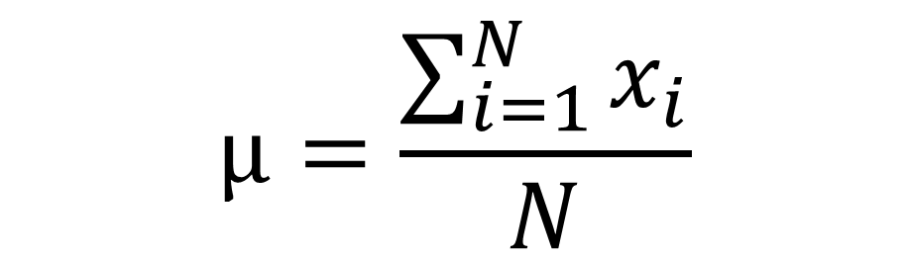
Standard Notation
Data Value
$$μ=\frac{\sum_{i=1}^{N}{x_{i}}}{N}$$
Population Mean
# Items in a Population

Slide 20
Central Tendency
A central tendency (or measure of central tendency) is a central or typical value for a probability distribution
We have seen the most common measures of central tendency
The Mode, Mean and Median
The central tendency of a distribution is typically contrasted with its dispersion or variability or scatter or spread
Analysis may judge whether data has a strong or a weak central tendency based on its dispersion

Slide 21
Measure of Variability
Do you know some measures of variability?
THE RANGE
THE SUM OF DEVIANCES
THE SUM OF SQUARED ERRORS
THE VARIANCE
THE STANDARD DEVIATION

Slide 22
The Range
[3, 5, 11, 12, 14, 16, 20, 23, 25, 27, 28, 29, 39, 40, 56]
Given the data set, what is the range?

Slide 23
The Range
The easiest way to try to quantify the spread or dispersion is to subtract the smallest value from the largest value
In our data set the smallest value is 0, the largest value is 100
The range is 0-100 (or 100)
What does this tell us?
One observation is that the team of markers are using the full range of marks available 0-100, which is good
If we removed our outliers (the non-submission) the range would be from 22-100 (or 78)
Not quite the full range of marks but a good proportion.
But, this really doesn’t give us an accurate measure of dispersion. Extreme single values can dramatically affect the range (thus how disperse the data is)

Slide 24
The Range
22,42,43,47,48,49,49,54,54,59,59,60,61,61,65,67,69,69,71,71,71,71,72,73,73,73,73,73,76,76,76,77,77,77,78,78,80,80,81,81,82,82,82,83,83,83,84,84,84,86,86,86,86,86,87,87,87,87,87,87,87,87,88,88,88,88,88,88,88,89,89,89,89,89,89,90,90,90,90,90,90,90,90,90,90,90,90,90,90,90,92,92,92,92,92,92,92,92,92,92,92,92,92,92,92,92,93,93,93,93,93,93,93,93,93,93,93,93,93,93,93,93,93,94,94,94,94,94,94,94,94,94,94,94,94,94,94,94,94,94,94,94,94,94,94,95,95,95,95,95,95,95,95,95,95,95,95,95,95,95,95,95,95,96,96,96,96,96,96,96,96,96,96,96,96,96,96,96,96,96,96,96,96,96,96,96,96,96,96,96,96,96,96,96,96,96,98,98,98,98,98,98,98,98,98,98,98,98,98,98,98,98,98,98,98,98,98,98,98,98,98,98,98,98,99,99,99,99,99,99,99,99,99,99,99,99,99,99,99,99,99,99,99,99,99,99,99,99,99,99,99,99,100,100,100,100,100,100,100,100,100,100,100,100,100,100,100,100,100,100,100,100
There is nothing between 22 and 42, but from 42 onwards there are relatively close data points (42… 47… 48…. 49… 54 …), if we removed the extreme value the range would be 58
This kind of makes sense, we have a bunch of 40’s, 50’s, 60’s, 70s, 80s, 90s, and several 100s.
Removing outliers is standard practice in statistics (i.e. the non-submissions), however, removing data that is relevant to our data set is not good practice. 22 is clearly a valid data point in our set

Slide 25
Range Summary
Very easy to compute
The values used to compute exist in the data set
But…
Only two values are used
Very sensitive to extreme values
Influenced by sample size (the larger the sample the greater the range)

Slide 26
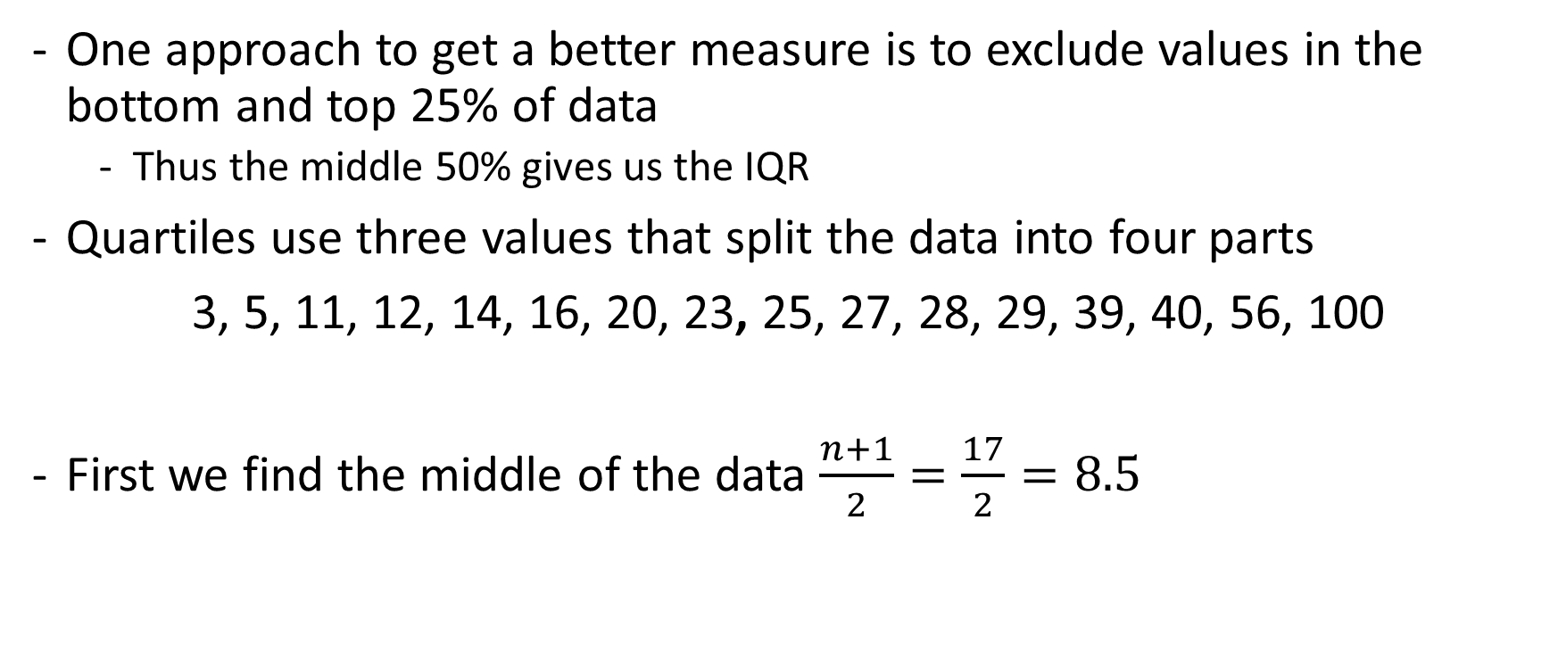
The Interquartile Range
One approach to get a better measure is to exclude values in the bottom and top 25% of data
Thus the middle 50% gives us the IQR
Quartiles use three values that split the data into four parts
3, 5, 11, 12, 14, 16, 20, 23, 25, 27, 28, 29, 39, 40, 56, 100
First we find the middle of the data $\frac{n+1}{2}=\frac{17}{2}=8.5$

Slide 27
The Interquartile Range
3, 5, 11, 12, 14, 16, 20, 23, 25, 27, 28, 29, 39, 40, 56, 100
Which allows us the calculate the median.
The median is 24, this gives us our second quartile (we have just split the data into two halves)
The lower quartile is the median of the lower half of the data and the upper quartile is the median of the upper half of the data

Slide 28
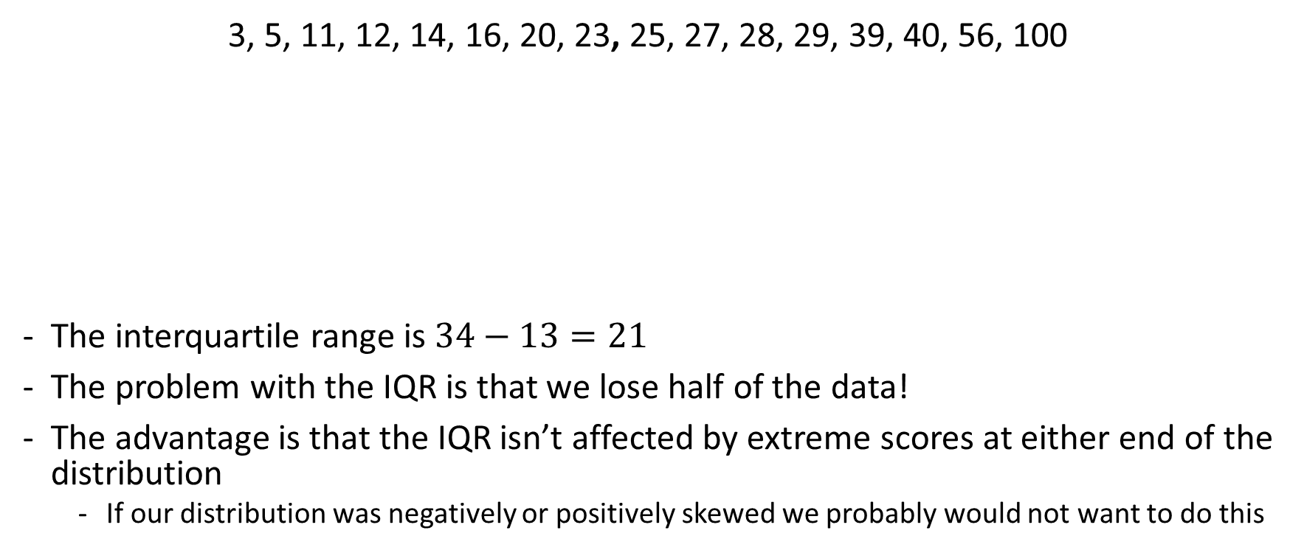
The Interquartile Range
3, 5, 11, 12, 14, 16, 20, 23, 25, 27, 28, 29, 39, 40, 56, 100
The interquartile range is $34−13=21$
The problem with the IQR is that we lose half of the data!
The advantage is that the IQR isn’t affected by extreme scores at either end of the distribution
If our distribution was negatively or positively skewed we probably would not want to do this
First
Quartile
Second
Quartile
Third
Quartile
13
24
34

Slide 29
IQR with our Data
22,42,43,47,48,49,49,54,54,59,59,60,61,61,65,67,69,69,71,71,71,71,72,73,73,73,73,73,76,76,76,77,77,77,78,78,80,80,81,81,82,82,82,83,83,83,84,84,84,86,86,86,86,86,87,87,87,87,87,87,87,87,88,88,88,88,88,88,88,89,89,89,89,89,89,90,90,90,90,90,90,90,90,90,90,90,90,90,90,90,92,92,92,92,92,92,92,92,92,92,92,92,92,92,92,92,93,93,93,93,93,93,93,93,93,93,93,93,93,93,93,93,93,94,94,94,94,94,94,94,94,94,94,94,94,94,94,94,94,94,94,94,94,94,94,95,95,95,95,95,95,95,95,95,95,95,95,95,95,95,95,95,95,96,96,96,96,96,96,96,96,96,96,96,96,96,96,96,96,96,96,96,96,96,96,96,96,96,96,96,96,96,96,96,96,96,98,98,98,98,98,98,98,98,98,98,98,98,98,98,98,98,98,98,98,98,98,98,98,98,98,98,98,98,99,99,99,99,99,99,99,99,99,99,99,99,99,99,99,99,99,99,99,99,99,99,99,99,99,99,99,99,100,100,100,100,100,100,100,100,100,100,100,100,100,100,100,100,100,100,100,100
IQR = 10
The IQR of 10 might appear strange since we have values ranging from 22 – 100, but the IQR represents the spread or how dispersed the data are in 50% of the data

Slide 30
IQR with our Data
22,42,43,47,48,49,49,54,54,59,59,60,61,61,65,67,69,69,71,71,71,71,72,73,73,73,73,73,76,76,76,77,77,77,78,78,80,80,81,81,82,82,82,83,83,83,84,84,84,86,86,86,86,86,87,87,87,87,87,87,87,87,88,88,88,88,88,88,88,89,89,89,89,89,89,90,90,90,90,90,90,90,90,90,90,90,90,90,90,90,92,92,92,92,92,92,92,92,92,92,92,92,92,92,92,92,93,93,93,93,93,93,93,93,93,93,93,93,93,93,93,93,93,94,94,94,94,94,94,94,94,94,94,94,94,94,94,94,94,94,94,94,94,94,94,95,95,95,95,95,95,95,95,95,95,95,95,95,95,95,95,95,95,96,96,96,96,96,96,96,96,96,96,96,96,96,96,96,96,96,96,96,96,96,96,96,96,96,96,96,96,96,96,96,96,96,98,98,98,98,98,98,98,98,98,98,98,98,98,98,98,98,98,98,98,98,98,98,98,98,98,98,98,98,99,99,99,99,99,99,99,99,99,99,99,99,99,99,99,99,99,99,99,99,99,99,99,99,99,99,99,99,100,100,100,100,100,100,100,100,100,100,100,100,100,100,100,100,100,100,100,100
Other observations
If you scored less than 88 you would have been in the bottom 25%
Between 89 – 94 your score would have been below 50% (below average?)
94 – 98 your score would be above 50% (above average?)
98 or higher your score is in the top 25%

Slide 31
IQR Summary
Fairly easy to compute
Scores exist in the data set
Eliminate influence of extreme values
Discards 50% of the data

Slide 32
Frequency Distribution and Probability
You can think of frequency distributions in terms of probability
So instead of asking, how frequently has a score occurred? we could ask what is the probability of a score occurring?
Examples:
What is the probability that a student will fail this assessment?
What is the probability that a student will achieve a first?

Slide 33
Frequency Distribution and Probability
Grade | # Achieved | Percent Achieved
10-19 | 0 | 0.0%
20 - 29 | 1 | 0.4%
30 - 39 | 0 | 0.0%
40 - 49 | 6 | 2.2%
50 - 59 | 4 | 1.5%
60 - 69 | 7 | 2.6%
70 - 79 | 20 | 7.3%
80 - 89 | 37 | 13.6%
90 - 100 | 198 | 72.5%
 | 273 | 1
What is the probability that a student will fail this assessment? 0.4%
What is the probability that a student will achieve a first? 93.4%
This is the rough idea, we can be more precise by using well established probability distributions. The Normal Distribution can be used to obtain probabilities by calculating a Z-score (or T-score), then looking up the value from a table of probability values.
We need the Standard Deviation and mean.

Slide 34
Statistics and Context
Before we move on!
Over the last few slides the statistics have maybe told you that you are not as good as you think you are!
Statistics can be ‘evil’ and interpreted in many different ways
You are probably familiar with the phrase “Lies, damned lies, and statistics”
This is the phrase describing the persuasive power of numbers, particularly the use of statistics.
70+ for coursework at undergraduate level is a ‘first class piece of work’
50-69 is a very good piece of work
40-49 is a good piece of work
If you weren’t at the top of your game, you would not have been admitted to The University of Manchester. Problem for ‘you’, everybody is at the top of their game.
However, you are not competing with each other, you are working to standards, assessment specifications and marking schemes.

Slide 35
Frequency Distribution
Very useful to plot a graph of how many times an event occurs
Often called a Frequency Distribution or Histogram
Observations normally plotted on the horizontal axis
However, they come in different shapes and size (i.e. stem-leaf plot)

Slide 36
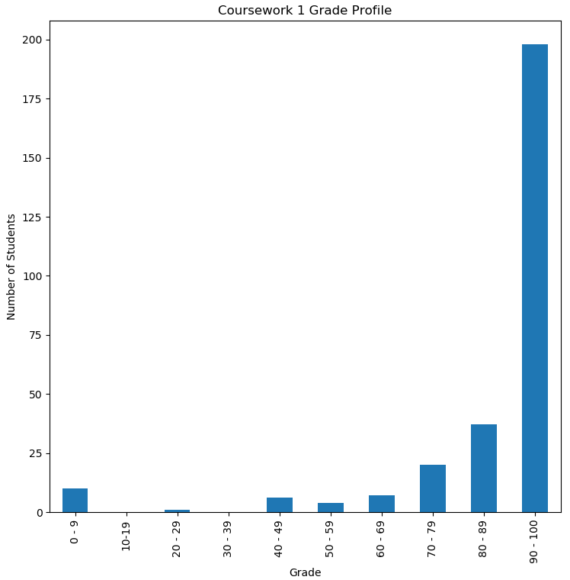
Python CW 1
Clearly for the most part, CW1 was too easy for the majority of students (don’t worry we will fix this)
A few students didn’t submit, or got a mark below 10
Almost all students passed
We can’t make assumptions why some students did not submit or did not pass, many external factors can come into play
If you are one of the students that did not pass and there are thing affecting your studies, or perhaps you have found programming difficult – come and speak with us, we can help!

Slide 37
Other Measures of Spread
We switch to another dataset to measure the other variance measures

Slide 38

Sum of Deviances
Ages | Average
18-21 | £16,478
22-29 | £26,551
30-39 | £36,207
40-49 | £40,448
50-59 | £38,307
60+ | £32,482
What if we just sum the deviances?
Will this give us a measure of spread?
$$sum of deviance=\sum{(x_{i}−μ)}$$
Average Salary in UK 2019
Office of National Statistics
The mean is £31,745
What is the total error?

Slide 39
Sum of Deviances
Ages | Average
18-21 | £16,478
22-29 | £26,551
30-39 | £36,207
40-49 | £40,448
50-59 | £38,307
60+ | £32,482
The variance = 0
But how can this be? There are clear deviances from the mean
The negative values and positive values are cancelling out
Average Salary in UK 2019
Office of National Statistics

Slide 40

Sum of Squares
Ages | Average
18-21 | £16,478
22-29 | £26,551
30-39 | £36,207
40-49 | £40,448
50-59 | £38,307
60+ | £32,482
To avoid values cancelling out each other we can square each of the errors
$$SS=\sum{{(x_{i}−μ)(x_{i}−μ)}^{}}$$
Average Salary in UK 2019
Office of National Statistics
The mean is £31,745
What is the sum of squared errors?
£399,313,590.166667

Slide 41
Sum of Squares
Ages | Average
18-21 | £16,478
22-29 | £26,551
30-39 | £36,207
40-49 | £40,448
50-59 | £38,307
60+ | £32,482
SS = 399,313,590.166667
It should be clear that the more datapoints added the greater the sum of squares will become
We could divide by the number of datapoints to overcome this problem
Average Salary in UK 2019
Office of National Statistics

Slide 42
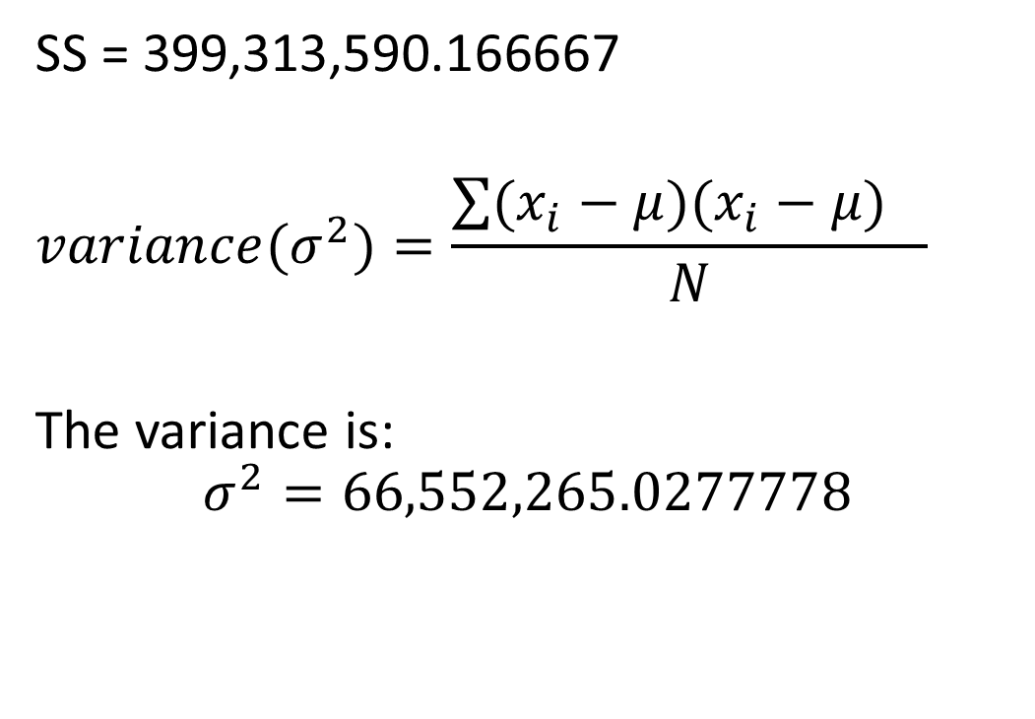
The Variance
Ages | Average
18-21 | £16,478
22-29 | £26,551
30-39 | £36,207
40-49 | £40,448
50-59 | £38,307
60+ | £32,482
SS = 399,313,590.166667
$$variance(σ^{2})=\frac{\sum{{(x_{i}−μ)(x_{i}−μ)}^{}}}{N}$$
The variance is:
$$σ^{2}=66,552,265.0277778$$
Average Salary in UK 2019
Office of National Statistics

Slide 43
Summary the Variance
Takes all data into account
Lends itself for computation of other stable measures and is a prerequisite for many of them (i.e. standard deviation)
Hard to interpret, what does 66,552,265.0277778 mean?
Can be influence by extreme scores

Slide 44
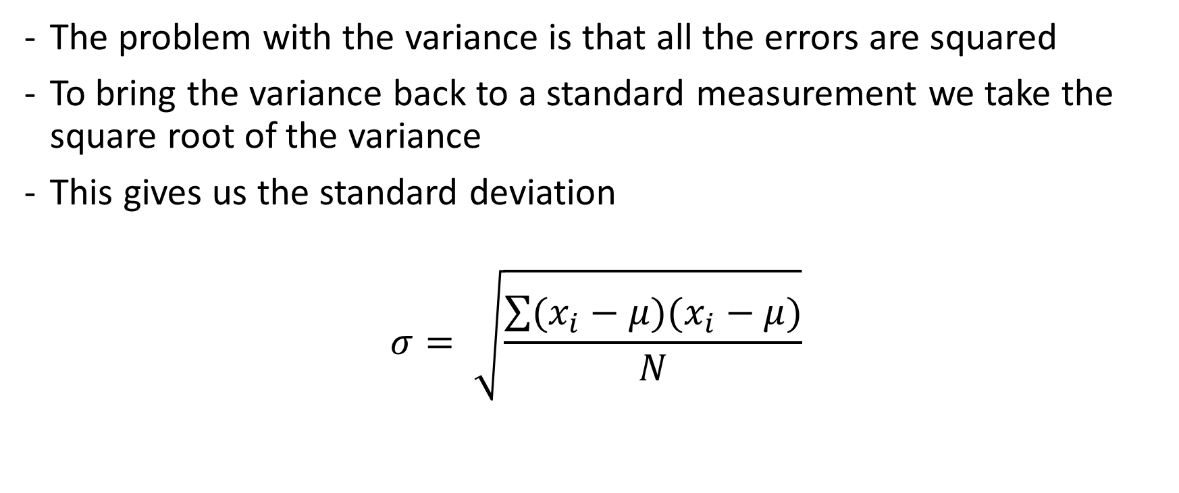
The Standard Deviation
The problem with the variance is that all the errors are squared
To bring the variance back to a standard measurement we take the square root of the variance
This gives us the standard deviation
$$σ= \sqrt{\frac{\sum{(x_{i}−μ)(x_{i}−μ)}}{N}}$$

Slide 45
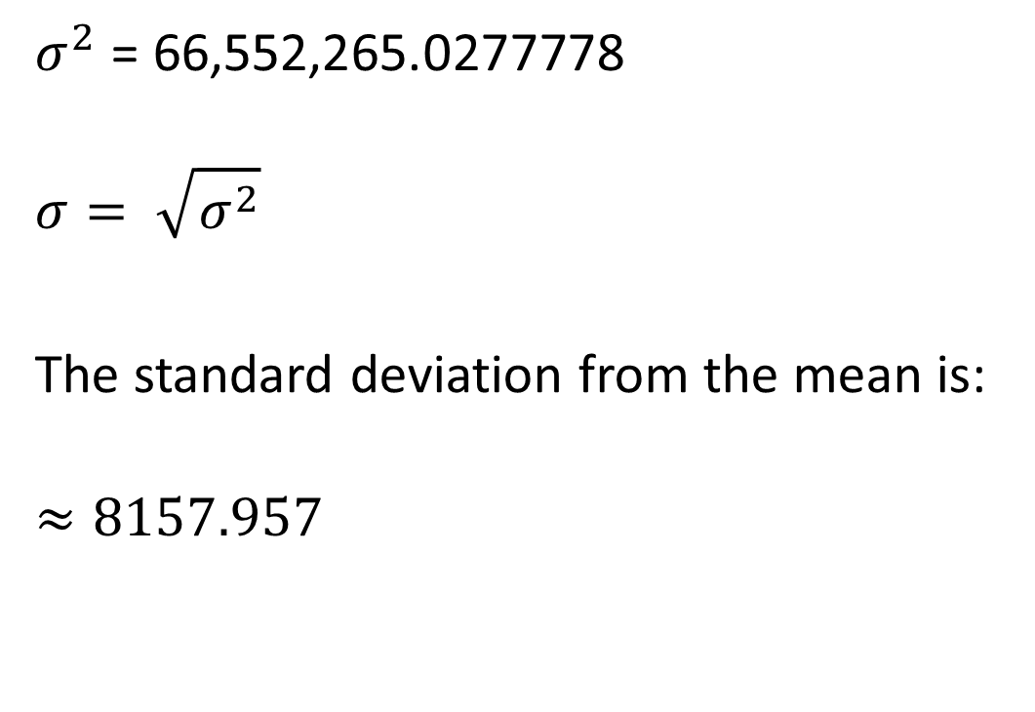
The Standard Deviation
Ages | Average
18-21 | £16,478
22-29 | £26,551
30-39 | £36,207
40-49 | £40,448
50-59 | £38,307
60+ | £32,482
$σ^{2}$ = 66,552,265.0277778
$$σ= \sqrt{σ^{2}}$$
The standard deviation from the mean is:
$$≈8157.957$$
Average Salary in UK 2019
Office of National Statistics

Slide 46
Summary the Standard Deviation
Lends itself to computation of other stable measures (and is a prerequisite for many of them).
Average of deviations around the mean.
Majority of data within one standard deviation above or below the mean.
Influenced by extreme values

Slide 47
Population and Samples
So far we have been dealing with populations
A population can be thought of as the entire data set
Often it is useful to work with samples which represent the population
It is seldom possible to obtain data for an entire population
Time/Hassle/Cost

Slide 48

Standard Deviation of a Sample
To find the standard deviation of a sample we use the same formula as seen to find the standard deviation of a population, but… we subtract one from the sample size
by just dividing by N we are underestimating the true population variance
More information here: https://towardsdatascience.com/why-sample-variance-is-divided-by-n-1-89821b83ef6d
$$s= \sqrt{\frac{\sum{{(x_{i}−\overline{x})}^{2}}}{n−1}}$$

Slide 49
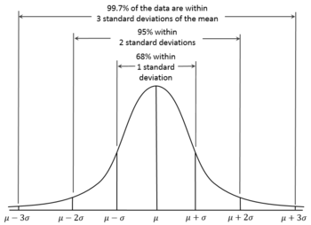
Empirical Rule
If data is normally distributed
The empirical rule states that 68% of data will fall within 1 standard deviation from the mean
95% within 2 standard deviations
99.7% within 3 standard deviations
A data values outside 3 standard deviations is extremely rare

Slide 50
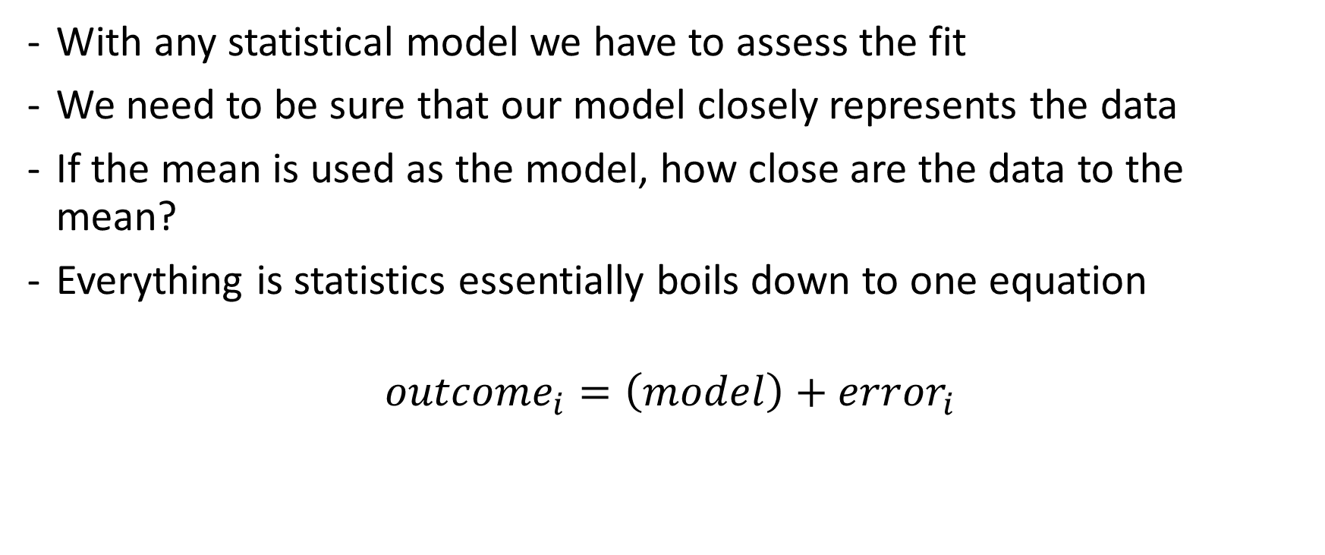
Assessing the fit of the Mean (or other statistic)
With any statistical model we have to assess the fit
We need to be sure that our model closely represents the data
If the mean is used as the model, how close are the data to the mean?
Everything is statistics essentially boils down to one equation
$${outcome}_{i}=\left(model\right)+{error}_{i}$$

Slide 51
The Standard Error
When you are conducting research, you often only collect data of a small sample of the whole population.
You are likely to end up with slightly different sets of values with slightly different means each time.
If you take enough samples from a population, the means will be arranged into a distribution around the true population mean.
The standard deviation of this distribution, i.e. the standard deviation of sample means, is called the standard error.
The lower the standard error, the closer it represents the population mean

Slide 52

Calculating the Standard Error
$$SE= \frac{σ}{\sqrt{n}}$$
Mean: 4.00 6.50 4.83 4.78
Std dev, s: 4.36 1.97 2.62 2.96
Sample size, n: 3 6 12 18
sqrt(n): 1.73 2.45 3.46 4.24
Standard error, s/sqrt(n): 2.52 0.81 0.76 0.70
An approximation of confidence intervals can be made using the mean +/- standard errors. Thus, in the above example, in Sample 4 there is a 95% chance that the population mean is within +/- 1.4 (=2*0.70) of the mean (4.78).

Slide 53
Learning Outcomes
After this lectures, students should be able to
Compute the mean, standard deviation, standard error, the median and the mode of a collection of real numbers.
Know when each are appropriate to used.

Slide 54
Take Away
A collection of numerical data can be summarized in various ways, which reveal different aspects of the data.
In different situations, different quantities are appropriate

Slide 55
Summary
Next,
Geometric Mean
Linear Models
Exploring Data with Graphs

